Slide 1
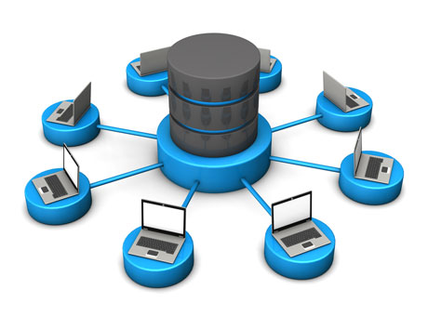
18XW32 - DATABASE MANAGEMENT SYSTEM

Slide 2
Outline
Course Information
Data vs Information
Database
Database Management Systems (DBMSs)
Database Systems
Conventional File Processing
Purpose of Database Systems
Characteristics of Database Approach
Advantages of using DBMS Approach
Actors on the scene and workers behind the scene
Database Concept and Architecture
Data Abstraction
Data Models, Instances and Schema
Components of a DBMS and DBMS Architectures

Slide 3
Books
TEXT BOOKS
Silberschatz A., Korth H and Sudarshan S., “Database System Concepts”, Tata McGraw Hill, 2011.
Elmasri R and Navathe S.B, “Fundamentals of Database Systems”, Pearson Education, 2015.
REFERENCES
Date C J,Kannan A, Swamynathan S, “An Introduction to Database Systems”, Pearson Education, 2009.
Raghu Ramakrishnan and Johannes Gehrke, “Database Management System (Digitized)”, Tata McGraw Hill, 2010.
Graeme C Simsion, “Data Modeling Essentials”, Dreamtech, 2006.

Slide 4
Course Prerequisites
Set Theory
  Definition of a Set
  Membership, Subset, Superset, Power set, Universal Set
  Operations on Sets
    Union, Intersection, Complement, Difference, Cartesian Product
  De Morgan’s Law
  Definitions of Relations
    Ordered Pairs and Binary Relations
    Domain, Range
    Properties – Reflexive, Symmetric, Antisymmetric, Transitive , Total
  Definitions of Functions
  Properties of Functions – Injective, Subjective, Bijective
  Compositions of Functions
  Inverse of a Function
  Basics of propositional
    Operations – Conjunction (and), disjunction (or), negation(not), implication, equivalence, Closure under Operations
  Predicate Logic
    Predicates, Quantification – Existential, Universal
Notes:
Discrete Mathematics

Slide 5
Course Prerequisites
Data Structures
  Array
  List
  Binary Search Tree
    Balanced Tree
  B-Tree
  Hash Table/Map
Algorithms
  Sorting
    Merge sort
    Quick Sort
  Search
    Linear Search
    Binary Search
    Interpolation Search
MOOCs
1. Discrete Mathematics
2. Design and Analysis of Algorithms
3. Fundamental Algorithms:Design and Analysis
https://nptel.ac.in/course.html

Slide 6
Data vs Information
Data - Known facts that can be recorded and that have implicit meaning
    Numeric - Order number, Quantities
    Alphabetic - Supplier name, Product name
    Alphanumeric - Supplier address
    Multimedia - Images, Audio, Video ( Google Maps, Retina scans, finger prints)
Information - processed data on which decisions and actions are based
    transformed data that has value for decision making
  Data is converted into information by programs and queries
Notes:
Data - Known Facts

Slide 7
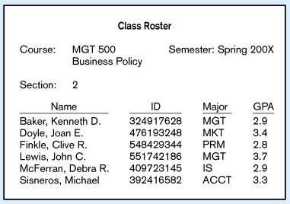
Data in Context

Slide 8

Converting Data to Information

Slide 9

Database
Database - collection of related data items within a specific business process or problem setting
Purchase Order System
  Data Items
    Products - product number, product name, and product color
    Suppliers - supplier name and supplier address
    Purchase orders – reference number and date
  Examples of relationships
    A product can be supplied by one or more suppliers
    A purchase order is always connected to exactly one supplier
    A supplier can supply one or more products

Slide 10
Database
University Database
  Data items
    Students
    Faculty
    Courses
    Offerings
    Enrollments
    Other possible entities: prerequisites, degree programs, building/room descriptions, departments
  Relationships
    What offerings are available for a course in a given academic period?
    Who is the instructor for an offering of a course?
    What students are enrolled in an offering of a course?

Slide 11
Database – Implicit Properties
A database represents some aspect of the real world, sometimes called a miniworld or the universe of discourse (UoD)
  Changes to the miniworld are reflected in the database.
  For example : Student grades and transcripts at a university
A database is a logically coherent collection of data with some inherent meaning
  Example : Address book
A database is designed, built, and populated with data for a specific purpose
  It has an intended group of users and some applications in which the user is interested

Slide 12
Example of a Database
Mini-world
  Part of a UNIVERSITY environment
Some mini-world entities
  STUDENTs
  COURSEs
  SECTIONs (of COURSEs)
  (academic) DEPARTMENTs
  INSTRUCTORs
Some mini-world relationships
  SECTIONs are of specific COURSEs
  STUDENTs take SECTIONs
  COURSEs have prerequisite COURSEs
  INSTRUCTORs teach SECTIONs
  COURSEs are offered by DEPARTMENTs
  STUDENTs major in DEPARTMENTs

Slide 13
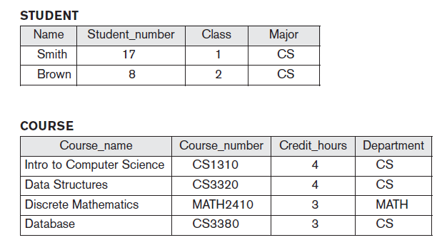
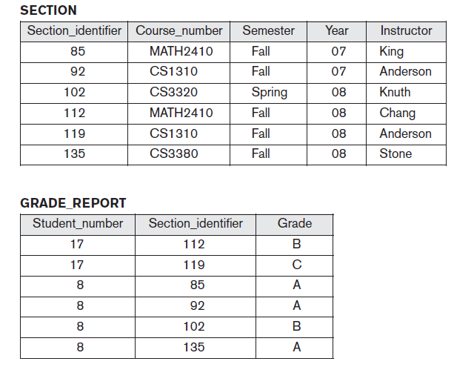
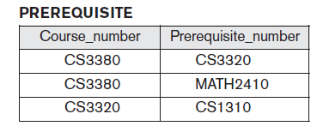
Example of a Database
Figure : A database that stores student and course information

Slide 14


Database Characteristics
Persistent
  Lasts a long time (not transient)
  Lasts longer than the execution of a computer program
Inter-related
Businesses - customers, employees, products, orders, courses, shipments and other vital entities.
Relationships among entities
  What orders have been placed by a customer
  What products have been shipped
  …

Slide 15

Database Characteristics
Shared - databases are shared with many
applications and many users simultaneously
interacting with the database
  For example:
    Many customers may be simultaneously making airline reservations
    Ordering products and
    Applying for a position
The database may support many applications such as orders, shipments, accounting and customer service
A university database supports a variety of applications such as registration, grade recording, assignment of faculty to course offerings and scheduling of courses

Slide 16
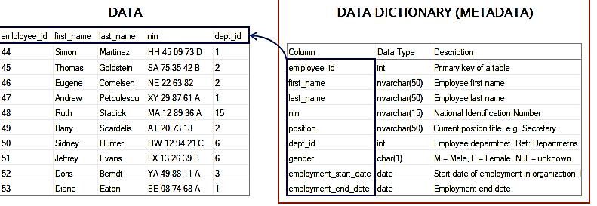
Database Management System (DBMS)
DBMS - a general-purpose software system that facilitates the processes of defining, constructing, manipulating, and sharing
databases among various users and applications
  Defining - involves specifying the data types, structures, and constraints of the data to be stored in the database.
    Meta-data - The database definition or descriptive information is also stored by the DBMS in the form of a database catalog or dictionary
Notes:
In ORACLE the Data Dictionary Includes
all_users
user_tables
user_tab_columns – columns in each table
user_constraints
user_views
use_sequences
user_procedures
user_triggers
user_indexes
user_clusters
…

Slide 17
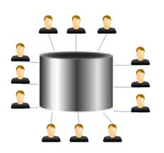
Database Management System
Constructing - process of storing the data on some storage medium that is controlled by the DBMS
  Populate DB with data
Manipulating - includes functions such as
  querying the database to retrieve specific data
    Query: “Which department pays the highest salary?”
  updating the database to reflect changes in the miniworld
    Increase the salaries of employees in Accounts department by 10%
  generating reports from the data
    Report - List monthly salaries of employees, organised by department, with average salary and total sum of salaries for each department
Sharing - allows multiple users and programs to access the database simultaneously
Notes:
Data manipulation – insert, delete, update

Slide 18


Database Management System
Other important functions provided by the DBMS
  Protection and
  Maintenance
Protection - includes
  system protection against hardware or software malfunction (or crashes)
  security protection against unauthorized or malicious access
Maintenance - allowing the system to evolve as requirements change over time

Slide 19







Examples of DBMSs
Oracle
MySQL
DB2
MS SQL Server
MS Access
Ingres
PostgreSQL
…

Slide 20
Database Applications
  Banking: customer inquiry, accounts, loan, and banking transactions
  Airlines: reservations, schedules
  Universities: course registration, grades, and other information
  Sales: customers, products, purchases
  Online retailers: order tracking, customized recommendations
  Manufacturing: production, inventory, orders, supply chain
  Human resources: employee records, salaries, tax deductions
  Telecommunication: records of calls made, generating monthly bills, maintaining balances of prepaid calling cards, etc
  …

Slide 21
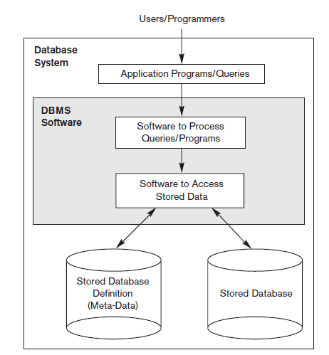
Database System
Database system
  Collection of interrelated data (Database)
  and a Set of programs that allow users to
  access and modify these data (DBMS)
  Database + DBMS software = Database
  System
Figure : A simplified database system environment

Slide 22
Retention Questions
Define the following terms
  Database
  DBMS
  Database system
Give some examples of applications of database technology

Slide 23

Conventional File Processing
Organizations stored data in file-processing system before DBMSs were introduced
University - keeps information about all instructors, students, departments, and course offerings - operating system FILES
To allow users to manipulate the information, the system has a number of application programs that manipulate the files
  Add new students, instructors, and courses
  Register students for courses and generate class rosters
  Assign grades to students, compute grade point averages (GPA), and generate transcripts
New application programs are added to the system as the need arises
  For example : a university decides to create a new major (say, computer science)
  New application programs may have to be written to handle new rules in the university. Thus, the system acquires more files and more application programs.

Slide 24
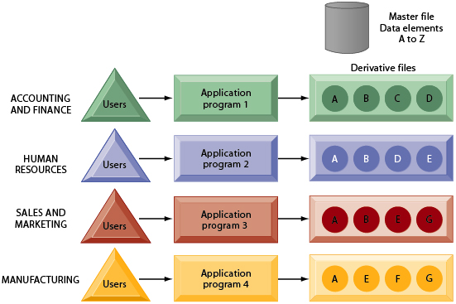
Conventional File Processing
Notes:
The use of a traditional approach to file processing encourages each functional area in a corporation to develop specialized applications and files. Each application requires a unique data file that is likely to be a subset of the master file. These subsets of the master file lead to data redundancy and inconsistency, processing inflexibility, and wasted storage resources.

Slide 25
Purpose of Database Systems
File-processing system has a number of major disadvantages
Data redundancy and inconsistency
  Different programmers create the files and application programs over a long period, the various files are likely to have different structures and the programs may be written in several programming languages
  Same information may be duplicated in several places (files)
    For example, the address and telephone number of a particular customer may appear in a file that consists of savings-account records and in a file that consists of checking-account records.
  The redundancy of data leads to higher storage and access cost
  The various copies of the same data may no longer agree – data inconsistency
    For example, a changed customer address may be reflected in savings-account records but not elsewhere in the system

Slide 26
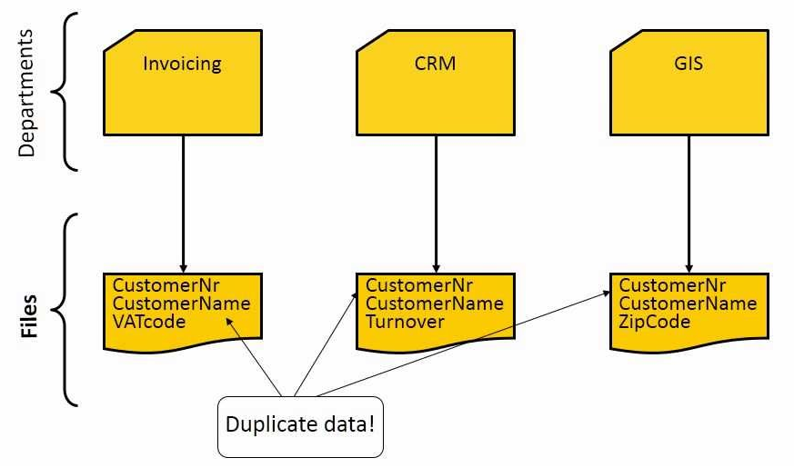
Purpose of Database Systems
The data files only contain the data themselves; the data definitions and descriptions are included in each application separately
An application can make use of one or more files
Figure : File-based Approach to Data Management

Slide 27
Purpose of Database Systems
Difficulty in accessing data
University clerks - needs to find out the names of all students who live within a particular postal-code area
Suppose that there is no application program on hand to meet it. But application program to generate the list of all students is available
Two Choices
  Obtain the list of all students and extract the needed information manually
  Ask a programmer to write the necessary application program
Both alternatives are unsatisfactory
Conventional file-processing - does not allow needed data to be retrieved in a convenient and efficient manner

Slide 28
Purpose of Database Systems
Data Isolation
  Because data are scattered in various files, and files may be in different formats, writing new application programs to retrieve the appropriate data is difficult
Integrity Problems
  The data values stored in the database must satisfy certain types of consistency constraints
  Hard to add new constraints or change existing ones
    Example - The balance of a bank account may never fall below a prescribed amount (say, Rs. 1000)
  The problem is compounded when constraints involve several data items from different files
Notes:
The term data integrity refers to the correctness and completeness of the data in a database.
To preserve the consistency and correctness of its stored data, a relational DBMS typically
imposes one or more data integrity constraints.

Slide 29
Purpose of Database Systems
Atomicity problems
  In many applications, it is crucial that, if a failure occurs, the data be restored to the consistent state that existed prior to the failure
  For example : Consider a program to transfer Rs. 5000 from the account balance of department A to the account balance of department B. If a system failure occurs during the execution of the program, it is possible that the Rs. 5000 was removed from the balance of department A but was not credited to the balance of department B, resulting in an inconsistent state.
  The fund transfer must be atomic - it must happen entirety or not at all
  Difficult to ensure atomicity in a conventional file-processing system

Slide 30
Purpose of Database Systems
Concurrent-access anomalies
  Concurrent access needed for performance
  Uncontrolled concurrent accesses can lead to inconsistencies
      Example: Shared Bank Account
Initial Balance =100
Begin Transaction T1 | Begin Transaction T2
Read Balance [100] | Read Balance [100]
Balance = Balance -100 | Balance = Balance +100
If Balance <0 Print “insufficient funds” abort T1 end Write Balance [0] | Write Balance [200]

Slide 31
Purpose of Database Systems
Security problems
    Hard to provide user access to some, but not all, data
Database systems - offer solutions to all the above problems

Slide 32
Characteristics of Database Approach
Main characteristics that distinguish DB approach from the file-processing approach
  Self-describing nature of a database system
  Insulation between programs and data, and data abstraction
  Support of multiple views of the data
  Sharing of data and multiuser transaction processing
Self-Describing Nature of a Database System
  Database system contains not only the database itself but also a complete definition or description of the database structure and constraints
  DBMS catalog - contains information such as
    the structure of each file
    the type and storage format of each data item
    various constraints on the data
This description is called meta-data

Slide 33
Characteristics of Database Approach
DBMS catalog - used by the DBMS software and database users
A general-purpose DBMS software package is not written for a specific database application
  must work equally well with any number of database applications
  For example, a university database, a banking database, or a company database as long as the database definition is stored in the catalog
Traditional file processing - data definition is typically part of the application programs themselves
  For example, an application program written in C++ may have struct or class declarations to define its files
Notes:
general-purpose DBMS software package
is not written for a specific database application. Therefore, it must refer to the
catalog to know the structure of the files in a specific database, such as the type and
format of data it will access. The DBMS software must work equally well with any
number of database applications—for example, a university database, a banking
database, or a company database

Slide 34
Characteristics of Database Approach
Program 1
Meta-Data
FILE SYSTEM
Program 2
Meta-Data
Data
Program 3
Meta-Data
Program 1
DATABASE
Meta-
Data
Program 2
Data
Program 3

Slide 35
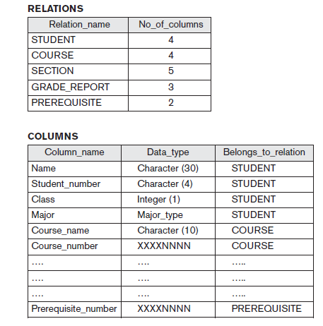
Characteristics of Database Approach
Figure : An example of a Database Catalog

Slide 36
Characteristics of Database Approach
Insulation between Programs and Data, and Data Abstraction
  Program-data independence
    Allows changing data structures and storage organization without having to change the DBMS access programs
    In traditional file processing - the structure of data files is embedded in the application programs, so any changes to the structure of a file may require changing all programs that access that file
Object-oriented and object-relational systems - users can define operations on data as part of the database definitions
  Program-operation Independence
    Operations (or methods for object class) specified in two parts:
      Interface (signature) includes operation name and data types of its arguments.
      Implementation (or method) can be changed without affecting the interface
Data abstraction - The characteristic that allows program-data independence and program-operation independence
Notes:
Objectdatabase++, objectDB

Slide 37
Characteristics of Database Approach
Support of Multiple Views of the Data
  Each user may see a different view of the database, which describes only the data of interest to that user
View
  Subset of the database
  Contains virtual data derived from the database files but is not explicitly stored
Multi-user DBMS
  Users have a variety of distinct applications
  Must provide facilities for defining multiple views

Slide 38
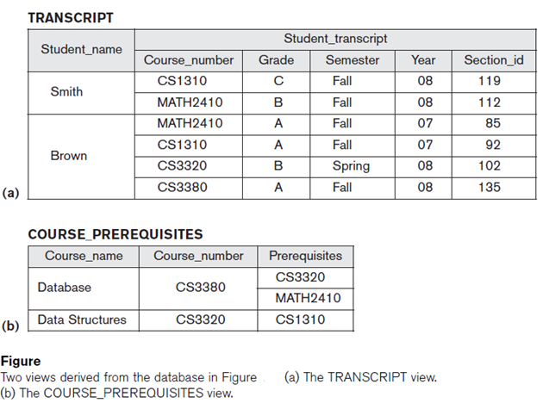
Characteristics of Database Approach

Slide 39
Characteristics of Database Approach
Sharing of Data and Multiuser Transaction Processing
Allow multiple users to access the database at the same time
Concurrency control software
  Ensures that several users trying to update the same data do so in a controlled manner
  Result of the updates is correct
    For example : Airline seat reservation
OnLine Transaction Processing (OLTP) is a major part of database applications.
  Allows hundreds of concurrent transactions to execute per second

Slide 40
Advantages of using DBMS approach
Controlling Redundancy
  Storing the same data multiple times leads to several problems
    entering data of a new student - multiple times: once for each file where student data is recorded - duplication of effort
    storage space is wasted
    Files that represent the same data may become inconsistent
  In database approach
    each logical data item - such as a student’s name or birth date- stored in only one place in the database - ensures consistency and saves storage space
Restricting Unauthorized Access
  When multiple users share a large database, it is likely that most users will not be authorized to access all information in the database
    financial data - only authorized persons are allowed to access, others are allowed to retrieve and update
  Security and authorization subsystem - to create accounts and to specify account restrictions

Slide 41
Advantages of using DBMS approach
Providing Persistent Storage for Program Objects
  Programming languages have complex data structures, such as record types in Pascal or class definitions in C++ or Java
  The values of program variables or objects are discarded once a program terminates, unless the programmer explicitly stores them in permanent files, which often involves converting these complex structures into a format suitable for file storage.
  Object-oriented database systems are compatible with programming languages such as C++ and Java, and the DBMS software automatically performs any necessary conversions
  A complex object in C++ can be stored permanently in an object-oriented DBMS. Such an object is said to be persistent - survives even after the termination of program execution and can later be directly retrieved by another C++ program
Notes:
Objectdatabase++, Objectstore, objectDB, Gemstone/S, Perst – Examples OODBs

Slide 42
Advantages of using DBMS approach
Providing Storage Structures and Search Techniques for Efficient Query Processing
  Database is typically stored on disk, the DBMS must provide specialized data structures and search techniques to speed up disk search
  Indexes - Auxiliary files, used speed up disk search
    based on tree data structure or hash data structures
  Buffering or caching module - maintains parts of the database in main memory buffers
  Query processing and optimization module – responsible for choosing an efficient query execution plan for each query based on the existing storage structures

Slide 43
Advantages of using DBMS approach
Providing Backup and Recovery
  Backup and recovery subsystem of the DBMS - responsible for recovery
  For example
    If the computer system fails in the middle of a complex update transaction, the recovery subsystem is responsible for making sure that the database is restored to the state it was in before the transaction started executing
Providing Multiple User Interfaces
  DBMS - provides a variety of user interfaces
    Query languages - casual users
    Programming language interfaces – application programmers
    Forms and command codes - parametric users
    Menu-driven interfaces and natural language interfaces - standalone users

Slide 44
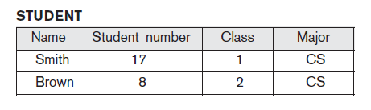
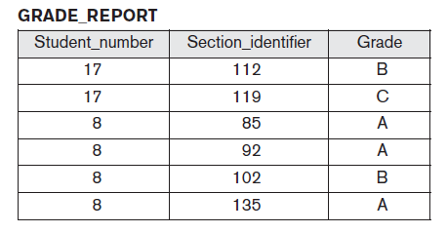
Advantages of using DBMS approach
Representing Complex Relationships among Data
  A database may include numerous varieties of data that are interrelated in many ways

Slide 45
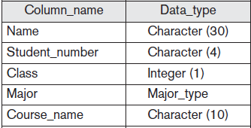
Advantages of using DBMS approach
Enforcing Integrity Constraints
  A DBMS should provide capabilities for defining and enforcing Integrity Constraints
  Simplest type of integrity constraint - specifying a data type for each data item
  More complex type of constraint - involves specifying that a record in one file must be related to records in other files
    For example, every section record must be related to a course record

Slide 46
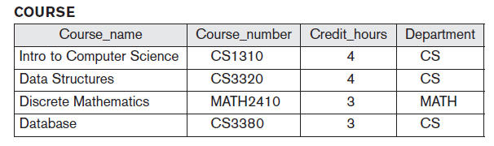
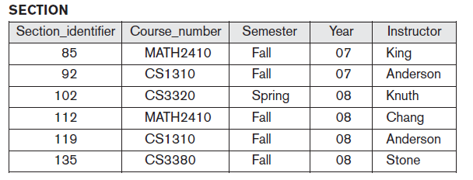
Advantages of using DBMS approach
Every course record must have a unique value for Course_number – Key or Uniqueness Constraint
Every section record must be related to a course record – Referential Integrity
Notes:
For typical large applications, it is customary to call such constraints business rules

Slide 47
Advantages of using DBMS approach
Permitting Inferencing and Actions Using Rules
    Deductive database systems - capable of defining deduction rules for Inferencing new information from the stored database facts
    Trigger - is a form of a rule activated by updates to the table, which results in performing some additional operations to some other tables, sending messages, and so on.
    Stored Procedures - to enforce rules overall database definition and are invoked appropriately when certain conditions are met
Additional Implications of Using the Database Approach
    Potential for Enforcing Standards
      DataBase Administrator (DBA) - defines and enforces standards easily among database users in a large organization
      Standards can be defined for names and formats of data elements, display formats, report structures, terminology, and so on
      facilitates communication and cooperation among various departments, projects, and users within the organization
Notes:
Steps in Query execution
Syntax error checking
Checking for the existence of objects( like tables, views, triggers, procedures, etc)
Query Optimization
Compile
Execute
Stored Procedures Advantages
Performance
Maintenance
Security

Slide 48
Advantages of using DBMS approach
Reduced Application Development Time
  Designing and implementing a large multiuser database from scratch may take more time than writing a single specialized file application
  Once a database is up and running, substantially less time is generally required to create new applications using DBMS facilities
Flexibility
  Changes to the structure of the database can be made easily without affecting the stored data and the existing application programs
Availability of Up-to-Date Information
  As soon as one user’s update is applied to the database, all other users can immediately see this update.
  Availability of up-to-date information is essential for many transaction-processing applications, such as reservation systems or banking databases

Slide 49
Advantages of using DBMS approach
Economies of Scale
  DBMS approach - permits consolidation of data and applications, thus reducing the amount of wasteful overlap between activities of data-processing personnel in different projects or departments as well as redundancies among applications
  Enables the whole organization to invest in more powerful processors, storage devices, or communication gear, rather than having each department purchase its own (lower performance) equipment

Slide 50
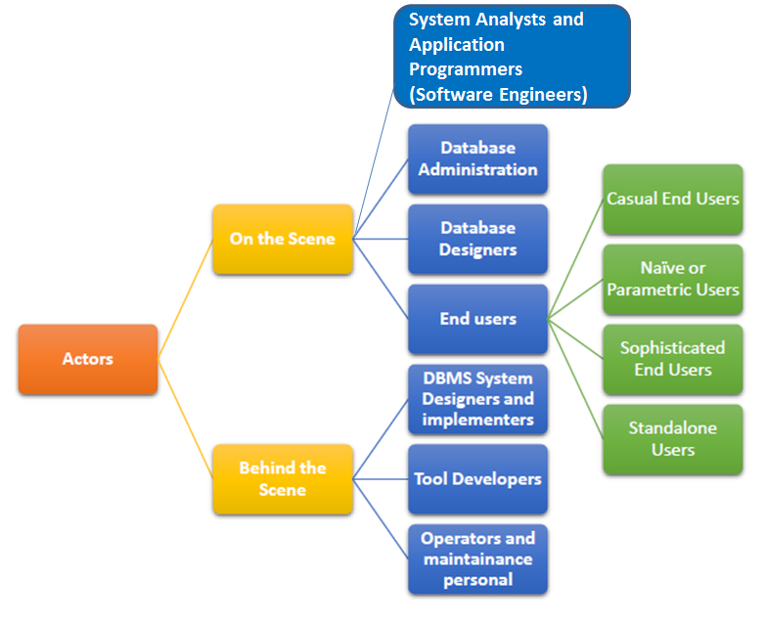
Actors - On and Behind the Scene

Slide 51
Actors on the Scene
1. Database Administrator (DBA)
DBA is responsible for
  Authorizing access to the database
  Coordinating and monitoring its use and
  Acquiring software and hardware resources as needed
DBA - accountable for problems such as security breaches and poor system response time
2. Database Designers
  Identifying the data to be stored in the database and
  Choosing appropriate structures to represent and store this data
Responsibility of database designers - communicate with all prospective database users in order to understand their requirements and to create a design that meets these requirements
Database designers typically interact with each potential group of users and develop views of the database that meet the data and processing requirements of these groups

Slide 52
Actors on the Scene
3. End Users
  People whose jobs require access to the database for querying, updating, and generating reports
Categories of end users
  a. Casual End Users
    Occasionally access the database
    Need different information each time
    Use a sophisticated database query language to specify their requests
    Typically middle- or high-level managers or other occasional browsers
  b. Naïve Users
    Constantly querying and updating the database
    Use standard types of queries and updates
    The tasks are
      Bank tellers check account balances and post withdrawals and deposits
      Reservation agents for airlines, hotels, and car rental companies check availability for a given request and make reservations

Slide 53
Actors on the Scene
c. Sophisticated end users
  include engineers, scientists, business analysts, and others who thoroughly familiarize themselves with the facilities of the DBMS in order to implement their own applications to meet their complex requirements
d. Standalone users
  maintain personal databases by using ready-made program packages that provide easy-to-use menu-based or graphics-based interfaces
  Example: user of a tax package that stores a variety of personal financial data for tax purposes
4. System Analysts and Application Programmers
  System analysts - determine the requirements of end users, especially naive end users, and develop specifications for standard canned transactions that meet these requirements
  Application programmers - implement these specifications as programs; then they test, debug, document, and maintain these canned transactions
Notes:
Canned transactions are standard types of queries and updates which are frequently used by Naive end users to constantly querying and updating database.

Slide 54
Workers Behind the Scene
These persons are typically not interested in the database content itself
1. DBMS system designers and implementers
  Design and implement the DBMS modules and interfaces as a software package
2. Tool developers
  Design and implement tools - the software packages that facilitate database modeling and design, database system design, and improved performance. Tools are optional packages that are often purchased separately
3. Operators and maintenance personnel (system administration
personnel)
  Responsible for the actual running and maintenance of the hardware and software environment for the database system
Notes:
Tools are optional packages that are often purchased separately. They include packages for database design, performance monitoring,
natural language or graphical interfaces, prototyping, simulation, and test data generation.

Slide 55
Data Models
Data Model
  a collection of concepts that can be used to describe the structure of a database
  the operations for manipulating these structures, and
  certain constraints that the database should obey
Provides the necessary means to achieve data abstraction
Data Model - Underlying the structure of a database
  A collection of conceptual tools for describing data, data relationships, data semantics, and consistency constraints
Structure - data types, relationships, and constraints that apply to the data
Data abstraction – refers to the suppression or hiding of details of data organization and storage, and the highlighting of the essential features for an improved understanding of data
  Different users can perceive data at their preferred level of detail

Slide 56
Data Models
Data Model Structure and Constraints
  Constructs are used to define the database structure
  Constructs typically include elements (and their data types) as well as groups of elements (e.g. entity, record, table), and relationships among such groups
  Constraints specify some restrictions on valid data; these constraints must be enforced at all times
Data Model Operations
  These operations are used for specifying database retrievals and updates by referring to the constructs of the data model
  Operations on the data model may include basic model operations (e.g. generic insert, delete, update) and user-defined operations (e.g. compute_student_gpa, update_inventory)

Slide 57
Categories of Data Models
High-level or conceptual data models
  Provide concepts that are close to the way many users perceive data. Conceptual data models use concepts such as entities, attributes, and relationships
  Entities – represents a real-world object or concept, such as an employee or a project from the miniworld that is described in the database
  Attribute - represents some property of interest that further describes an entity, such as the employee’s name or salary.
  Relationship among two or more entities represents an association among the entities, for example, a works-on relationship between an employee and a project
Low-level or physical data models
  Provide concepts that describe the details of how data is stored in the computer

Slide 58
Categories of Data Models
Representational (or implementation) Data Models
  Provide concepts that may be understood by end users but that are not too different from the way data is organized within the computer
  Hide some details of data storage but can be implemented on a computer system in a direct way „
  Used by many commercial DBMS implementations (e.g. relational data models used in many commercial systems)

Slide 59
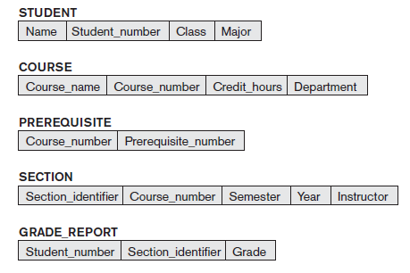
Schemas, Instances, and
Database State
Database Schema
  Description of a database (overall design of the database) - specified during database design and is not expected to change frequently
  Schema Diagram -„ An illustrative display of a database schema
  Schema Construct - „ A component of the schema or an object within the schema, e.g., STUDENT, COURSE
Displays only some aspects of a schema, such as
  the names of record types and data items, and
  some types of constraints
Figure : Schema diagram for the University database

Slide 60
Database State
Database state - the actual data stored in a database at a particular moment in time
Also called the database instance (or occurrence or snapshot)
In a given database state, each schema construct has its own current set of instances
  For example, the STUDENT construct will contain the set of individual student entities (records) as its instances
Every time we insert or delete a record or change the value of a data item in a record, we change one state of the database into another state

Slide 61
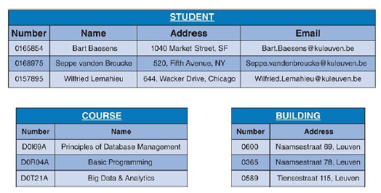
Schema Vs State
The database schema changes very infrequently
The database state changes every time the database is updated „
Schema is also called intension whereas State is also called extension
Database State
Schema
Student (number, name, address, email)
Course (number, name)
Building (number, address)

Slide 62
Database Schema and Database State
When we define a new database, we specify its database schema only to the DBMS
  At this point, the corresponding database state is the empty state with no data
Initial state of the database - when the database is first populated or loaded with the initial data
  From then on, every time an update operation is applied to the database, we get another database state
At any point in time, the database has a current state
DBMS - partly responsible for ensuring that every state of the database is a valid state
  Valid state - a state that satisfies the structure and constraints specified in the schema

Slide 63
Three-Schema Architecture
Three of the four important characteristics of the database approach
  (1) use of a catalog to store the database description (schema) so as to make it self-describing
  (2) insulation of programs and data (program-data and program-operation independence) and
  (3) support of multiple user views
Three-schema architecture - proposed to help achieve these characteristics
Goal of three-schema architecture - to separate the user applications from the physical database
Internal level – has an internal schema, which describes the physical storage structures and access paths(indexes)
  Uses a physical data model and describes the complete details of data storage and access paths for the database

Slide 64
Three-Schema Architecture
Conceptual level – has a conceptual schema, which describes the structure of the whole database for a community of users
  The conceptual schema hides the details of physical storage structures and concentrates on describing entities, data types, relationships, user operations, and constraints
  Uses a conceptual or an implementation data model
External or View level – includes a number of external schemas or user views
  Each external schema describes the part of the database that a particular user group is interested in and hides the rest of the database from that user group
  Each external schema is typically implemented using a representational data model, possibly based on an external schema design in a high-level data model

Slide 65
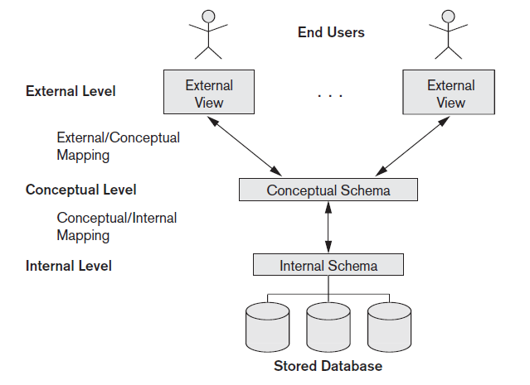
Three-Schema Architecture
The processes of transforming requests and results between levels are called mappings
Notes:
The processes of transforming requests and results between levels are called mappings

Slide 66
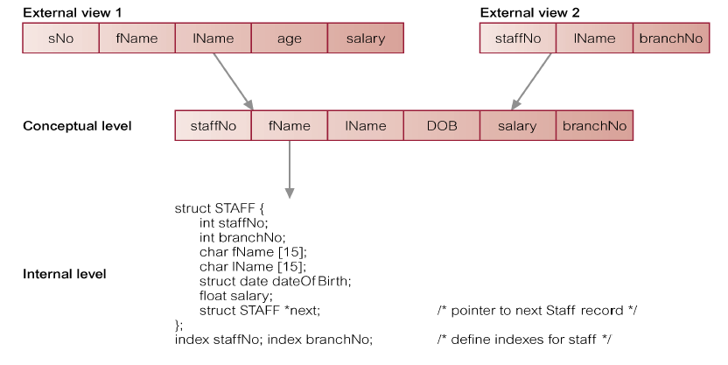
Three-Schema Architecture

Slide 67
Data Independence
Three-schema architecture - can be used to explain the concept of data independence
Data Independence
  the capacity to change the schema at one level of a database system without having to change the schema at the next higher level
Two types of data independence
  Logical data independence
  Physical data independence

Slide 68
Data Independence
Logical Data Independence
  The capacity to change the conceptual schema without having to change the external schemas and their associated application programs
  We may change the conceptual schema to expand the database (by adding a record type or data item), to change constraints, or to reduce the database (by removing a record type or data item)
  After the conceptual schema undergoes a logical reorganization, application programs that reference the external schema constructs must work as before

Slide 69
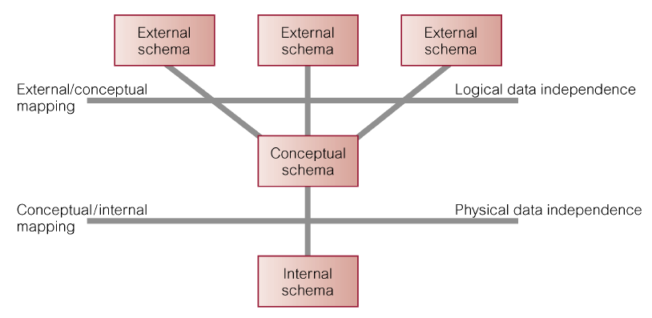
Data Independence

Slide 70
Data Independence
Physical Data Independence
  The capacity to change the internal schema without having to change the conceptual schema
  Hence, the external schemas need not be changed as well
  Changes to the internal schema may be needed because some physical files were reorganized
    For example, by creating additional access structures - to improve the performance of retrieval or update

Slide 71
Retention Questions
Define the following terms
  Data Model
  Database Schema
  Database State or Snapshot
  Empty state, Initial state, Current state, Valid state of the database
  Data Independence
    Physical data independence
    Local data independence

Slide 72
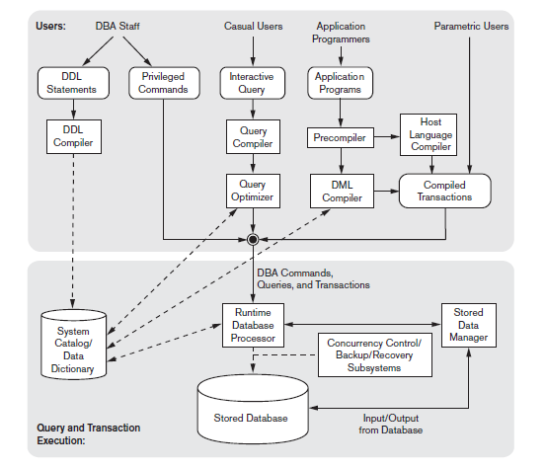
DBMS Component Modules
Top Part
Various users of
the database environment and their interfaces
Lower part
The internals of
the DBMS responsible
for storage of data
and processing of
transactions
Notes:
Statistical Data: It stores statistical information about the data in the database. This information is used by query processor to select efficient ways to execute query.
The CREATE TABLE privilege, for example, lets you create tables
The DELETE privilege, for example, lets you delete rows from tables and views.

Slide 73
DBMS Component Modules
DBMS - Complex software system
The database and the DBMS Catalog - stored on disk
Stored data manager module - controls access to DBMS information that is stored on disk, whether it is part of the database or the catalog
Top Part
  Interfaces
  DBA staff - defining the database and making changes to its definition using the DDL and other privileged commands
  Casual users - who work with interactive interfaces to formulate queries
  Application programmers - who create programs using some host programming languages, and
  Parametric users - who do data entry work by supplying parameters to predefined transactions

Slide 74
DBMS Component Modules
DDL compiler - processes schema definitions, specified in the DDL, and stores descriptions of the schemas (meta-data) in the DBMS catalog
Catalog contains
  Names and sizes of files
  Names and data types of data items
  Storage details of each file
  Mapping information among schemas
  Constraints
Interactive query
  Casual users and persons with occasional need for information from the database interact using some form of interface

Slide 75
DBMS Component Modules
Query Compiler
  Queries are parsed and validated for correctness of the query syntax, the names of files and data elements, and so on and compiles them into an internal form
Query Optimizer
  Concerned with the rearrangement and possible reordering of operations, elimination of redundancies, and use of correct algorithms and indexes during execution
Application programmers
  Write programs in host languages such as Java, C, or C++ that are submitted to a precompiler
Precompiler
  Extracts DML commands from an application program written in a host programming language. These commands are sent to the DML compiler for compilation into object code for database access

Slide 76
DBMS Component Modules
Host language compiler
  Compiles application program written in a host programming language after DML statements are extracted
Compiled Transactions
  The object codes for the DML commands and the rest of the program are linked, forming a canned transaction whose executable code includes calls to the runtime database processor
Runtime Database Processor – executes
  (1) the privileged commands
  (2) the executable query plans and
  (3) the canned transactions with runtime parameters
It works with system catalog and stored data manager

Slide 77
DBMS Component Modules
Stored data manager
  Uses basic operating system services for carrying out low-level input/output (read/write) operations between the disk and main memory
Concurrency control and Backup and recovery systems
  are integrated into the working of the runtime database processor for purposes of transaction management

Slide 78
DBMS Architectures
Database applications can be partitioned into two or three parts
Earlier-generation database applications used a Two-tier Architecture, where
  the application resides at the client machine, and invokes database system functionality at the server machine through query language statements
Clients
  Provide appropriate interfaces through a client software module to access and utilize the various server resources
  Clients may be diskless machines or PCs or Workstations with disks with only the client software installed
  Connected to the servers via some form of a network
    (LAN: local area network, wireless network, etc.)

Slide 79
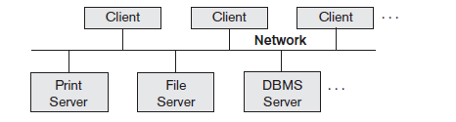
DBMS Architectures – Two-tier
Server
  Provides database query and transaction services to the clients
  Relational DBMS servers are often called SQL servers, query servers, or transaction servers
  Applications running on clients utilize an Application Program Interface (API) to access server databases via standard interface such as:
    ODBC: Open Database Connectivity standard
    JDBC: for Java programming access
  Client and server must install appropriate client module and server module software for ODBC or JDBC
Figure : Logical Two-tier client/server architecture

Slide 80
Three-tier Architecture
Common for Web applications
Intermediate Layer called Application Server or Web Server
  Stores the web connectivity software and the business logic part of the application used to access the corresponding data from the database server
  Acts like a conduit for sending partially processed data between the database server and the client
Three-tier Architecture Can Enhance Security
  Database server only accessible via middle tier
  Clients cannot directly access database server

Slide 81
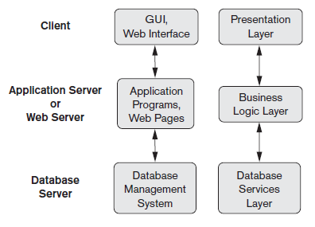
Three-tier Architecture
Figure : Logical Three-tier client/server architecture

Slide 82

END OF CHAPTER - I

